Slide 1
Chapter Overview
Understanding NTFS Permissions
Assigning NTFS Permissions
Assigning Special Permissions

Slide 2
Understanding NTFS Permissions
NT file system (NTFS) permissions are rules associated with file system objects that specify which users can access an object and in what manner.

Slide 3
Understanding NTFS Permissions (Cont.)
You use NTFS permissions to control access to files and folders on NTFS volumes.
NTFS permissions are available only on NTFS volumes.
Unlike share permissions, NTFS permissions are effective whether a user accesses a file or folder locally or over the network.

Slide 4
Controlling Access to NTFS Folders
NTFS folder permissions control access to the folder, including its files and subfolders.
Administrators typically assign NTFS permissions to folders rather than to files.
  It is easier to assign permissions to one folder than to the multiple individual files within the folder.

Slide 5
Controlling Access to NTFS Folders (Cont.)
Standard NTFS folder permissions
  Full Control
  Modify
  Read & Execute
  List Folder Contents
  Read
  Write

Slide 6
Controlling Access to NTFS Files
NTFS file permissions control access to specific files.
Standard NTFS file permissions
  Full Control
  Modify
  Read & Execute
  Read
  Write

Slide 7
What Is an Access Control List?
NTFS stores an access control list (ACL) with every file and folder on an NTFS volume.
The ACL lists
  All user accounts and groups that have been granted or denied access to the file or folder
  The type of access that they have been granted or denied

Slide 8
Managing Multiple NTFS Permissions
A user account can receive NTFS permissions to a file or folder from more than one source at the same time.
  For example, a user can receive permissions to a file or folder by having them assigned to the individual user account and to each group that the user is a member of.
Special rules and priorities determine how NTFS combines multiple permissions.

Slide 9
Permissions Are Cumulative
A user’s effective permissions for a file or folder are the sum of the NTFS permissions assigned to the individual user account for that resource and to all of the groups the user belongs to.
  For example, if a user has the Read permission for a folder and is a member of a group with the Write permission for the same folder, the user has both Read and Write access to that folder.

Slide 10
File Permissions Override Folder Permissions
NTFS file permissions take priority over NTFS folder permissions.
It is possible for a user to have permission to a file, but not to the folder that contains the file.
  In this case, the user cannot browse for the folder, so the user needs to specify the file’s full Universal Naming Convention (UNC) or local path to open the file.

Slide 11
Deny Overrides Other Permissions
NTFS permissions can be allowed or denied.
The deny permission takes precedence over other permissions.
Even if the user has permission to access a resource, if the user is a member of any group that is denied access to the resource, access is denied.

Slide 12
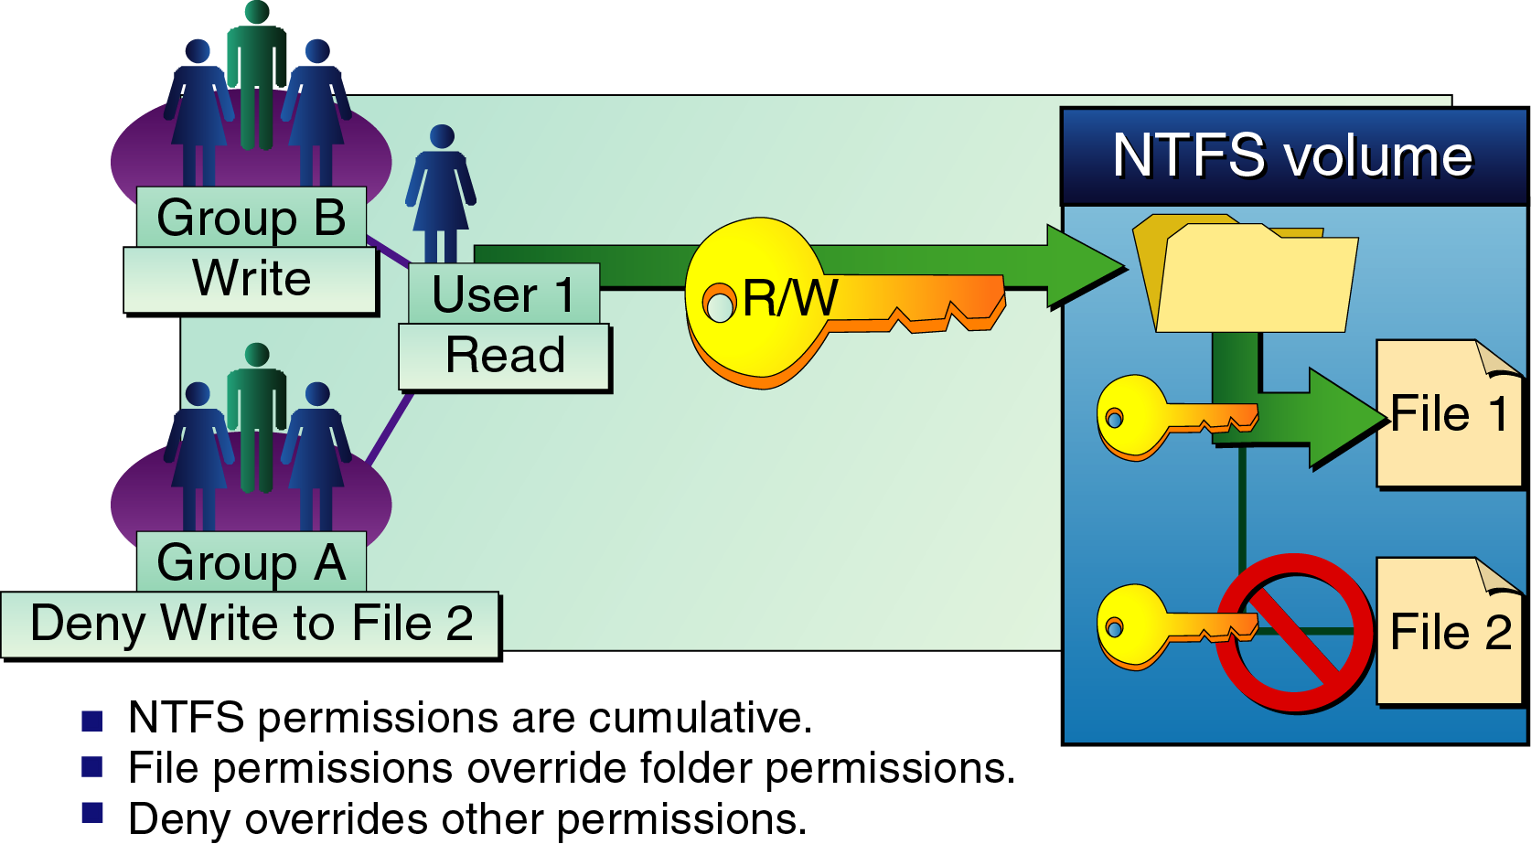
NTFS Permission Combination Rules

Slide 13
NTFS Permissions Inheritance
By default, NTFS permissions assigned to a parent folder are inherited by (and propagated to) the subfolders and files contained in the parent folder.
It is possible to prevent permissions inheritance.

Slide 14
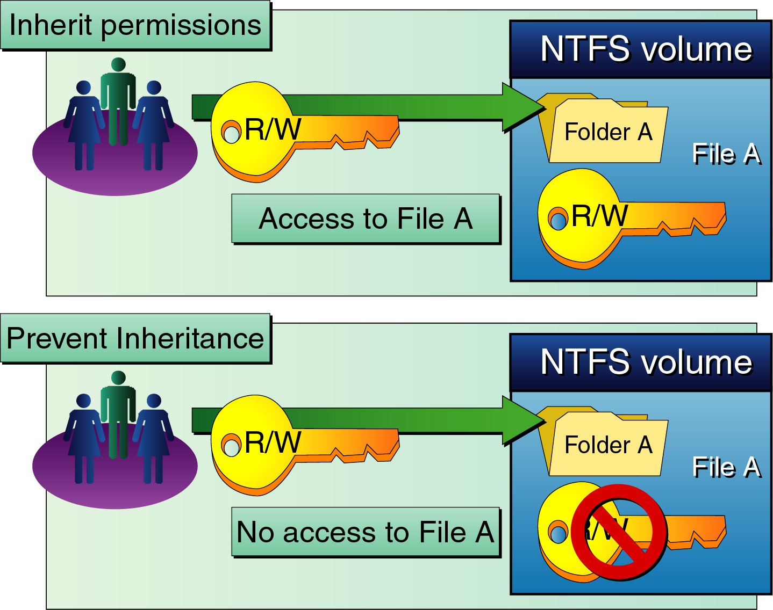
Permissions Inheritance

Slide 15
Understanding Permissions Inheritance
Files and subfolders can inherit permissions from their parent folder.
When you assign NTFS permissions to grant a user or group access to a folder, you are also assigning that user or group the same access to any files and subfolders in that folder.

Slide 16
Preventing Permissions Inheritance
You can set an option that prevents a file or folder from inheriting any permissions from its parent folder.
If you block the permissions inheritance for a folder, that folder becomes the top parent folder.
  Permissions that you assign to this folder are still inherited by the subfolders and files it contains.

Slide 17
Lesson Summary
NTFS permissions control access to files and folders on NTFS volumes.
NTFS permissions are cumulative.
You can deny permissions as well as allow them; denied permissions always take precedence over allowed permissions.
Files and subfolders can inherit permissions from their parent folder.

Slide 18
Assigning NTFS Permissions
Assess the needs of your users and groups.
Devise a permission strategy to provide for those needs.

Slide 19
Planning NTFS Permissions
Develop a method for assigning permissions and use it consistently.
Make sure all administrators understand and use the same method.

Slide 20
Guidelines for Assigning NTFS Permissions
Turn off the permissions inheritance for users’ home folders.
When assigning permissions for public data folders, assign the Full Control permission to the CREATOR OWNER identity group.
Deny permissions only when absolutely necessary.

Slide 21
Setting NTFS Permissions
When you format a volume with NTFS, the Full Control permission is assigned to the Everyone group by default.
You should consider changing this default permission and assigning other NTFS permissions to control access to resources.
You should be careful in assigning permissions to the Everyone group and enabling the Guest account.
  Microsoft Windows 2000 authenticates as Guest any user who does not have a valid user account; the user receives all of the rights and permissions assigned to the Everyone group.
  If you decide to remove permissions from the Everyone group, first ensure that other users have Full Control permission over the resources you are modifying.

Slide 22
Assigning or Modifying Permissions
The following can assign or modify NTFS permission on a file or folder:
  Administrators
  Users with the Full Control permission
  Owners of the file or folder
You assign or modify NTFS permissions by configuring the Security tab in the file or folder’s Properties dialog box in Windows Explorer.

Slide 23
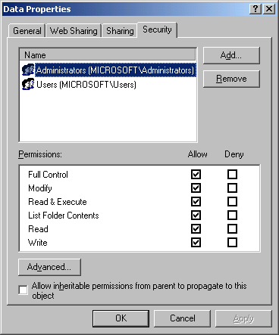
The Security Tab of the Properties Dialog Box for a Folder

Slide 24
Preventing Permissions Inheritance
Subfolders and files inherit the permissions that are assigned to their parent folder.
To prevent a subfolder or file from inheriting permissions from a parent folder, clear the Allow Inheritable Permissions From Parent To Propagate To This Object check box in the Security tab of the Properties dialog box for the subfolder or file.

Slide 25
Preventing Permissions Inheritance (Cont.)
After clearing the check box, select one of these options:
  Copy: copies the permissions from the parent folder to the current folder but prevents all subsequent permissions inheritance
  Remove: removes the permissions that are assigned to the parent folder and retains only the permissions you explicitly assign to the file or folder
  Cancel: cancels the dialog box, restoring normal permissions inheritance for the file or folder

Slide 26
Lesson Summary
When planning NTFS permissions, create a strategy and apply it throughout your enterprise.
Assign NTFS permissions to a file or folder by using the Security tab in the file or folder’s Properties dialog box in Windows Explorer.
To block permissions inheritance, clear the Allow Inheritable Permissions From Parent To Propagate To This Object check box.

Slide 27
Assigning Special Permissions
The standard NTFS permissions normally provide all of the access control you need to secure your file system resources.
If you need a more specific level of access, you can assign NTFS special permissions.

Slide 28
Understanding Special Permissions
Standard permissions are preconfigured combinations of more granular permissions, called special permissions.

Slide 29
Special Permissions
Traverse Folder/Execute File
List Folder/Read Data
Read Attributes
Read Extended Attributes
Create Files/Write Data
Create Folders/Append Data
Write Attributes
Write Extended Attributes
Delete Subfolders And Files

Slide 30
Special Permissions (Cont.)
Delete
Read Permissions
Change Permissions
Take Ownership
Synchronize

Slide 31
Assigning Special Permissions
Use the Permission Entry dialog box in the Permissions tab in the Access Control Settings dialog box for the file or folder.
To access this dialog box:
  1. In Windows Explorer, open the Properties dialog box for the file or folder.
  2. Click the Security tab.
  3. Click Advanced.
Select an entry in the Permission Entries list, and then click View/Edit to display the special permissions for the user or group.

Slide 32
Assigning Change Permissions
When this special permission is assigned to a user for a file or folder, the user can modify the permissions for the file or folder but cannot delete or write to the file or folder.
This permission is often assigned to other administrators.

Slide 33
Using the Take Ownership Permission
This special permission gives users or groups the ability to take over the ownership of files or folders.
Those who can take ownership of a file or folder include
  The current owner of the file or folder
  Any user with the Full Control permission for the file or folder
  Any user who is assigned the Take Ownership special permission for the file or folder
  Administrators, who can always take ownership of any file or folder, regardless of assigned permissions

Slide 34
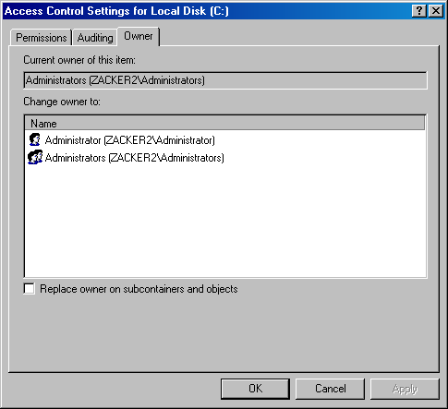
The Owner Tab in the Access Control Settings Dialog Box

Slide 35
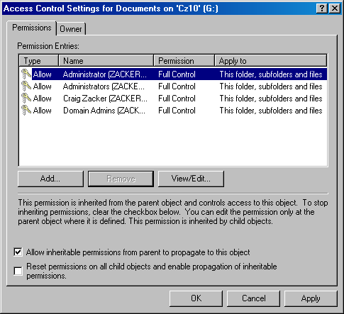
The Permissions Tab in the Access Control Settings Dialog Box

Slide 36
Lesson Summary
Special permissions provide more granular control than do standard NTFS permissions.
Standard permissions are preconfigured combinations of special permissions.
Two important special permissions are Change Permissions and Take Ownership.
You assign special permissions and take ownership of a file or folder by using the Access Control Settings dialog box.

